Slide 1


High Performance Computing for Aerospace Engineering
Authors:
Angel Pan Du
Yi Qiang Ji Zhang
Alba Molina Cuadrado
Ivan Sermanoukian Molina
Professor/s:
Manel Soria
Arnau Miró

Slide 2
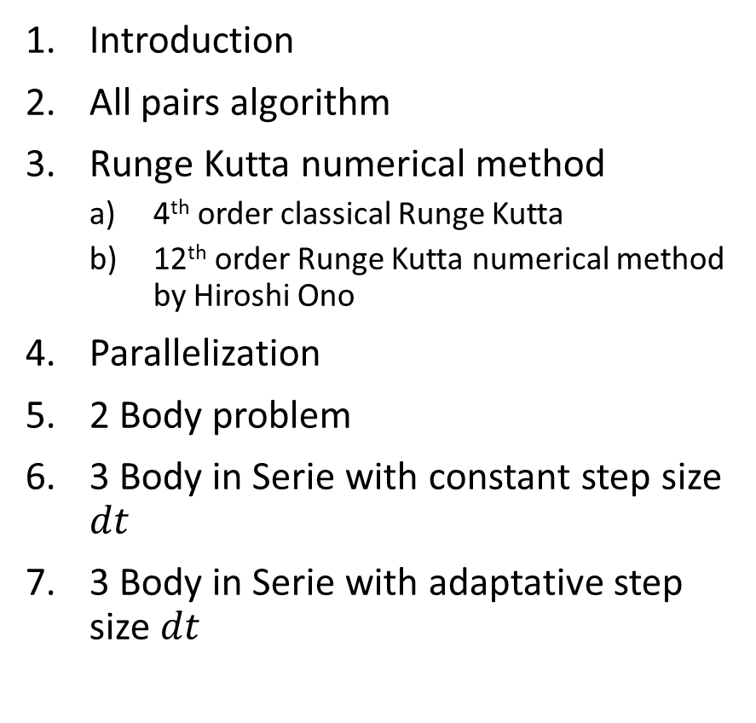
Table of contents
Introduction
All pairs algorithm
Runge Kutta numerical method
4th order classical Runge Kutta
12th order Runge Kutta numerical method by Hiroshi Ono
Parallelization
2 Body problem
3 Body in Serie with constant step size $dt$
3 Body in Serie with adaptative step size $dt$
Validation of results
More optimized algorithms
Further improvements
Conclusions

Slide 3
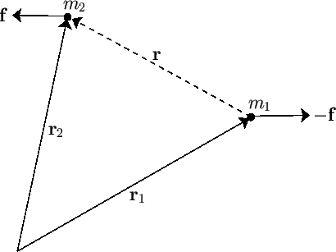
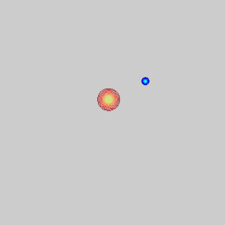
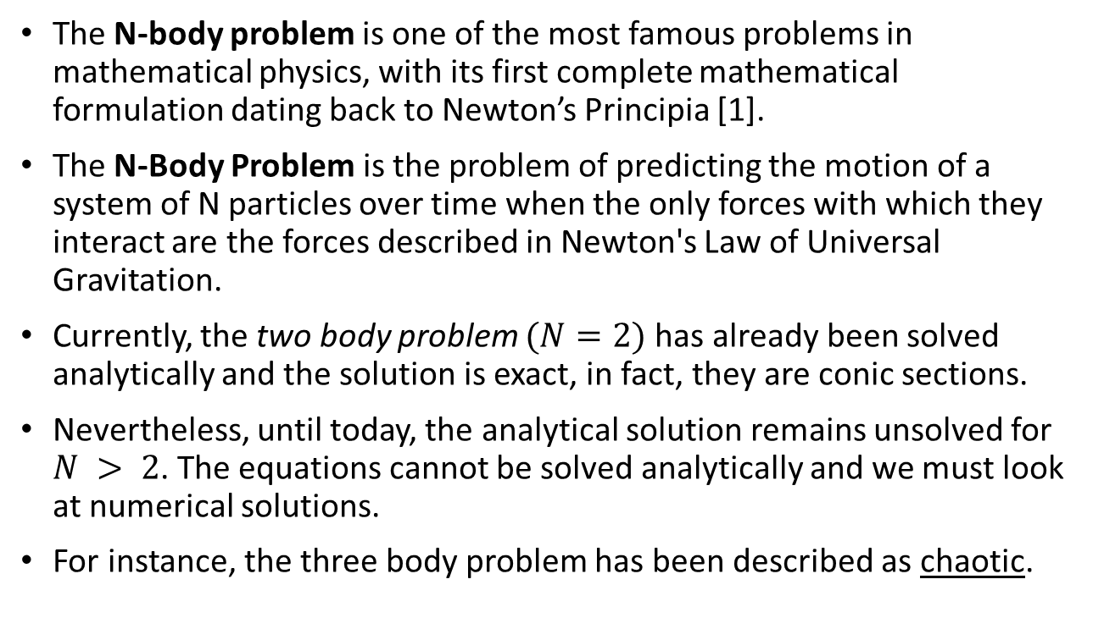
Introduction
The N-body problem is one of the most famous problems in mathematical physics, with its first complete mathematical formulation dating back to Newton’s Principia [1].
The N-Body Problem is the problem of predicting the motion of a system of N particles over time when the only forces with which they interact are the forces described in Newton's Law of Universal Gravitation.
Currently, the two body problem $(N=2)$has already been solved analytically and the solution is exact, in fact, they are conic sections.
Nevertheless, until today, the analytical solution remains unsolved for $N > 2$. The equations cannot be solved analytically and we must look at numerical solutions.
For instance, the three body problem has been described as chaotic.
Forces in a two body problem [2].
[1] Aarseth, S. (2003). Gravitational N-Body Simulations: Tools and Algorithms (Cambridge Monographs on Mathematical Physics). Cambridge: Cambridge University Press. doi:10.1017/CBO9780511535246
[2] Fitzpatrick, R. (2016).Two-body problem. https://farside.ph.utexas.edu/teaching/celestial/Celestial/node11.html (accessed: 11-04-2021)
[3] Yanovsky, I. (2008).Point Vortices. Two-body problem. https://www.math.ucla.edu/~yanovsky/Research/VortexSheets/2body.htm (accessed: 11-04-2021)
The evolution of two bodies interaction [3].

Slide 4
Introduction (cont.)
A chaotic system can be described as a system that are deterministic for an initial state, meaning that no randomness is involved in the development of future states of the system but are highly sensitive on initial conditions [1].
It is actually not possible to write down all the terms of a general formula that describes the motion of three or more gravitational objects. The issue lies in how many unknown variables a N body system contains.
For N>2, there are more unknowns than equations describing them.
[1] Lauterborn W.(2003) Chaotic Systems. https://www.sciencedirect.com/topics/computer-science/chaotic-systems
Notes:
https://www.sciencedirect.com/topics/computer-science/chaotic-systems

Slide 5
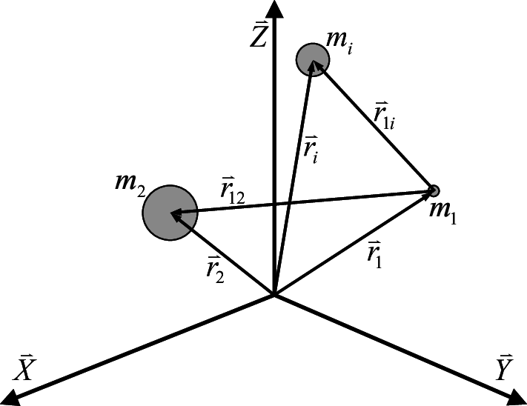
Introduction (cont.)
The N-Body problem can be stated as:
“Given n bodies with masses and initial position and velocities, how will they evolve over time under gravitational interaction?”
For N = 3, solutions exist in special cases (i.e. restricted three-body problem).
In general, numerical methods must be used to simulate such systems.
Forces on a 3 Body system [1].
[1] A. Stahl. Benjamin.(2008) Forces on a 3 Body system. https://www.researchgate.net/figure/The-N-body-problem_fig1_264840302

Slide 6
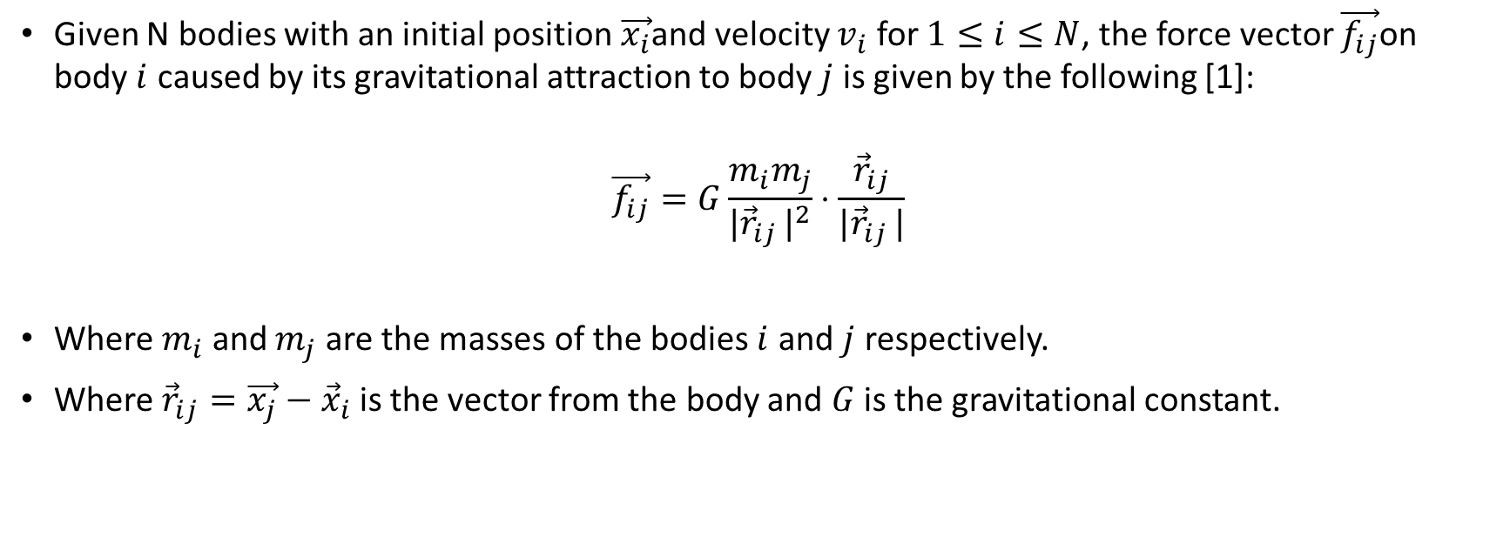
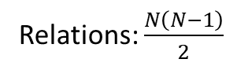
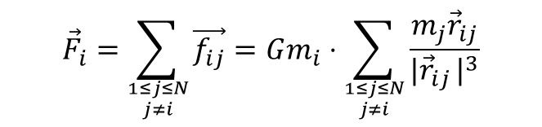
Introduction (cont.)
Given N bodies with an initial position $\vec{x_{i}}$and velocity $v_{i}$ for $1≤i≤N$, the force vector $\vec{f_{ij}}$on body $i$ caused by its gravitational attraction to body $j$ is given by the following [1]:
$$\vec{f_{ij}}=G\frac{m_{i}m_{j}}{\left.|{\vec{r}}_{ij}\right.|^{2}}⋅\frac{{\vec{r}}_{ij}}{\left.|{\vec{r}}_{ij}\right.|}$$
Where $m_{i}$ and $m_{j}$ are the masses of the bodies $i$ and $j$ respectively.
Where ${\vec{r}}_{ij}=\vec{x_{j}}−{\vec{x}}_{i}$ is the vector from the body and $G$ is the gravitational constant.
For N = 5, the relationships between particles follows the subsequent pattern:
$${\vec{F}}_{i}=\sum_{{1≤j≤N \atop j≠i}}{\vec{f_{ij}}}=Gm_{i}⋅\sum_{{1≤j≤N \atop j≠i}}{\frac{m_{j}{\vec{r}}_{ij}}{\left.|{\vec{r}}_{ij}\right.|^{3}}}$$
12 23 34 45
13 24 35
14 25
15
Relations: $\frac{N\left(N−1\right)}{2}$
[1] Nyland, L., Harris, M., & Prins, J. (2009). Fast N-body simulation with CUDA NVIDIA
Notes:
https://www.researchgate.net/publication/291770155_Fast_N-body_simulation_with_CUDA/link/553ed7ed0cf20184050fa13c/download
https://developer.nvidia.com/gpugems/gpugems3/part-v-physics-simulation/chapter-31-fast-n-body-simulation-cuda

Slide 7
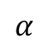
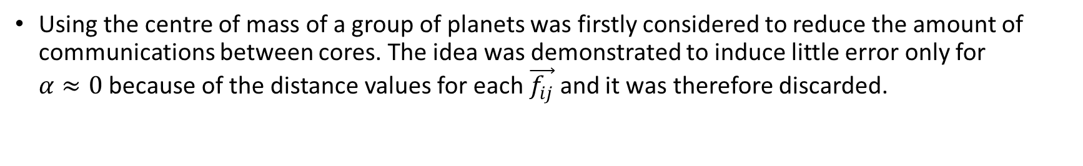
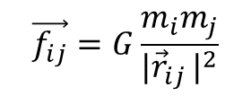
Centre of Mass
$$\vec{f_{ij}}=G\frac{m_{i}m_{j}}{\left.|{\vec{r}}_{ij}\right.|^{2}}$$
$$α$$
Using the centre of mass of a group of planets was firstly considered to reduce the amount of communications between cores. The idea was demonstrated to induce little error only for $α≈0$ because of the distance values for each $\vec{f_{ij}}$ and it was therefore discarded.

Slide 8
What have we programmed ?
Adapted the Runge Kutta’s method from C++ to C.
Programmed the Twobody() problem in series in C.
Programmed the Twobody() problem in parallel in C.
Programmed the Nbody() problem in series using All Pairs algorithm.
Programmed the Nbody() problem in parallel using All Pairs algorithm.
The resultant plot animations in MATLAB.

Slide 9
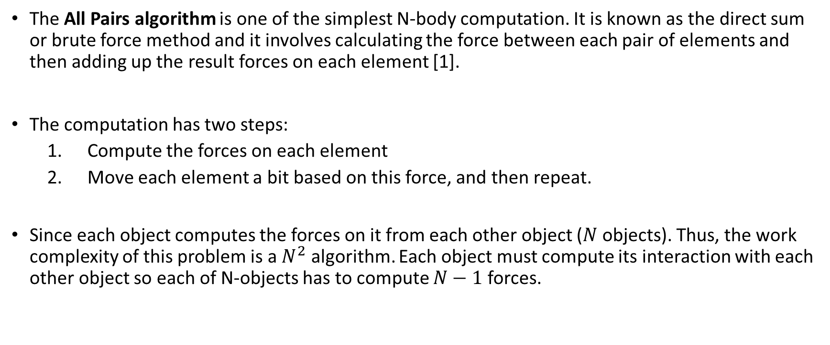
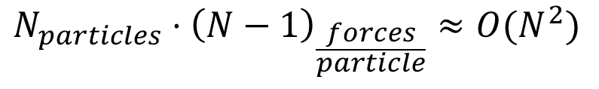
All Pairs Algorithm
The All Pairs algorithm is one of the simplest N-body computation. It is known as the direct sum or brute force method and it involves calculating the force between each pair of elements and then adding up the result forces on each element [1].
The computation has two steps:
Compute the forces on each element
Move each element a bit based on this force, and then repeat.
Since each object computes the forces on it from each other object ($N$ objects). Thus, the work complexity of this problem is a $N^{2}$ algorithm. Each object must compute its interaction with each other object so each of N-objects has to compute $N−1$ forces.
$$N_{particles}⋅{\left(N−1\right)}_{\frac{forces}{particle}}≈{O(N}^{2})$$
[1] Narlikar, G. (2009). Parallel N-Body Simulations. https://www.cs.cmu.edu/~scandal/alg/nbody.html (accessed: 11-04-2021)
Notes:
https://www.researchgate.net/publication/291770155_Fast_N-body_simulation_with_CUDA/link/553ed7ed0cf20184050fa13c/download
https://developer.nvidia.com/gpugems/gpugems3/part-v-physics-simulation/chapter-31-fast-n-body-simulation-cuda

Slide 10
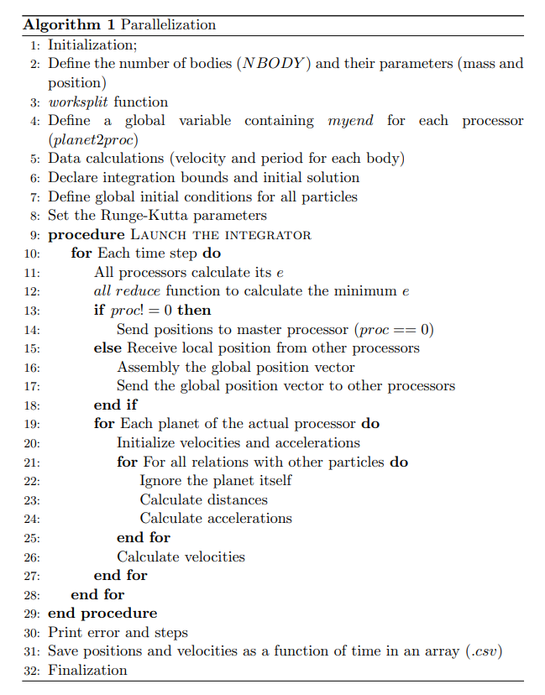
All Pairs Algorithm
The pseudocode is shown here:
0
1
2
3

Slide 11
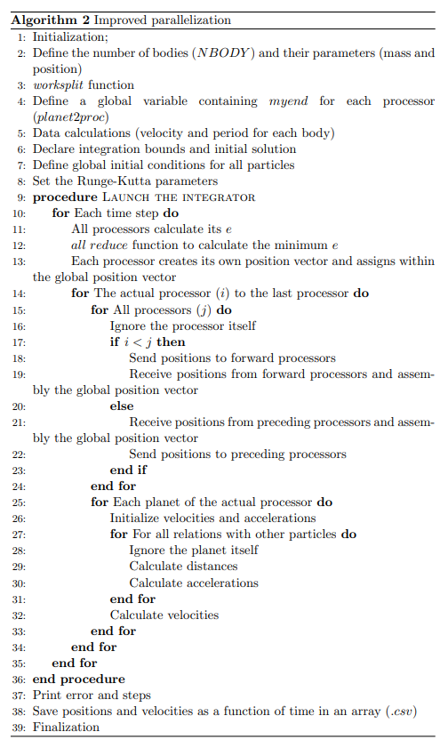
All Pairs Algorithm
Another parallelization method:
0
1
3
2

Slide 12
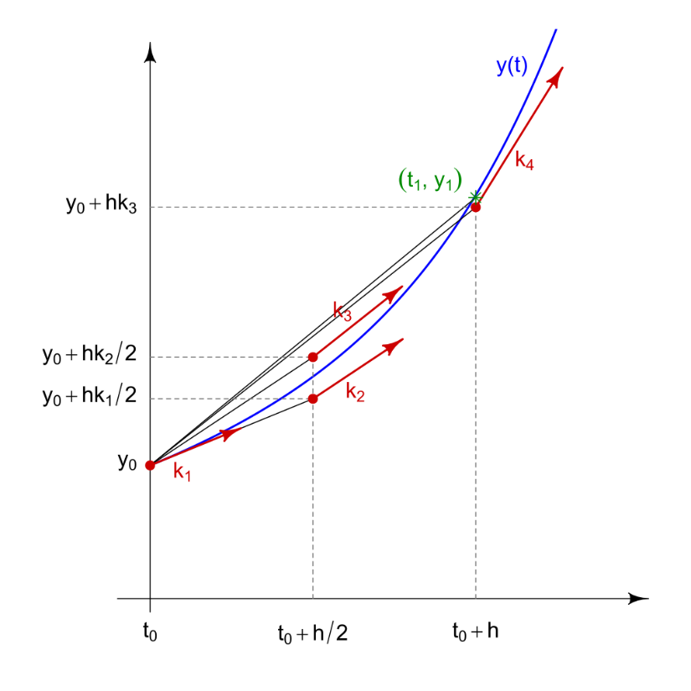
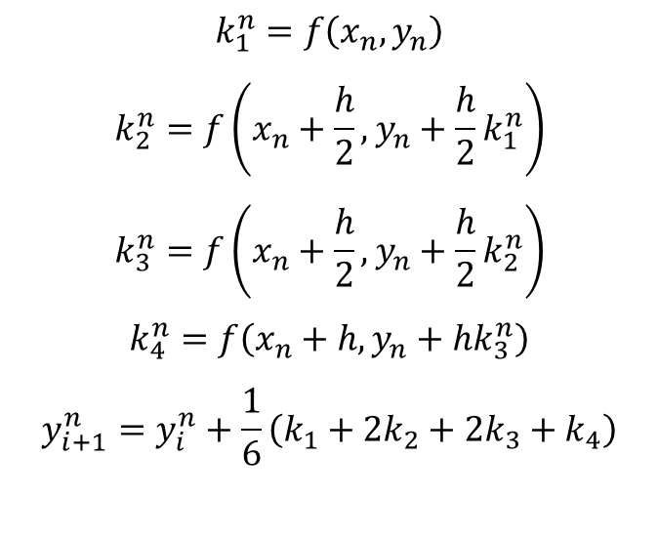
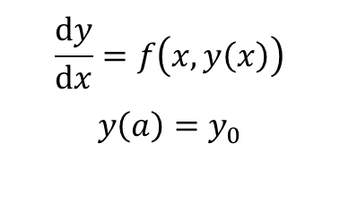
4th order Runge Kutta numerical method
Runge Kutta is a iterative method which includes the Euler method used in temporal discretization for the approximate solutions of ordinary differential equations.
Considering a differential equation with its initial condition:
$$\frac{ⅆy}{ⅆx}=f\left(x,y\left(x\right)\right)$$
$$y\left(a\right)=y_{0}$$
$$k_{1}^{n}=f\left(x_{n},y_{n}\right)$$
$$k_{2}^{n}=f\left(x_{n}+\frac{h}{2},y_{n}+\frac{h}{2}k_{1}^{n}\right)$$
$$k_{3}^{n}=f\left(x_{n}+\frac{h}{2},y_{n}+\frac{h}{2}k_{2}^{n}\right)$$
$$k_{4}^{n}=f\left(x_{n}+h,y_{n}+hk_{3}^{n}\right)$$
$$y_{i+1}^{n}=y_{i}^{n}+\frac{1}{6}\left(k_{1}+2k_{2}+2k_{3}+k_{4}\right)$$
Slopes used by the classical Runge-Kutta method
Zeltkevic, M. (1998).Runge-Kutta Methods. https://web.mit.edu/10.001/Web/Course_Notes/Differential_Equations_Notes/node5.html (accessed: 11-04-2021)

Slide 13
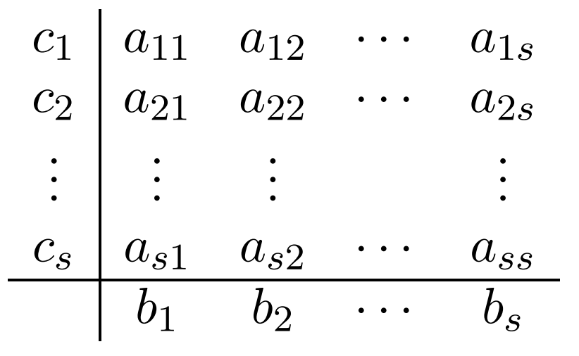
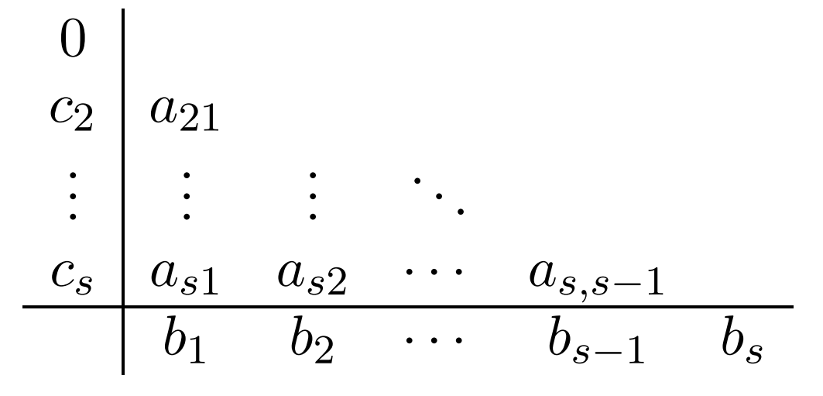
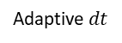
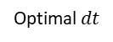
12th order Runge Kutta numerical method by Hiroshi Ono
The Hiroshi Ono Runge Kutta method adapts the classical Runge Kutta but with a 12th order approximation. [1] [2]
Besides, the advantage of this method is that it uses an adaptive step size depending on function and increasing its speed.
An optimal way to implement the code is to represent the method by using the buthcler’s table which encompasses all the RK coefficients [2]:
Optimal $dt$
Important
region
Adaptive $dt$
If the method is explicit, by the simplified tableau
[1] Press, W. H., & Teukolsky, S. A. (1998). Adaptive Stepsize Runge-Kutta Integration. Computers in Physics, 6 (188)
[2] Ono, Hiroshi. On the 25 stage 12th order explicit Runge-Kutta method. Transactions of the Japan Society for Industrial and applied Mathematics, Vol. 6, No. 3, (2006) pages 177 to 186
Notes:
http://www.peterstone.name/Maplepgs/Maple/nmthds/RKcoeff/Runge_Kutta_schemes/RK12/RKcoeff12e_1.pdf

Slide 14
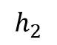
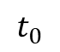
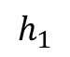
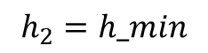
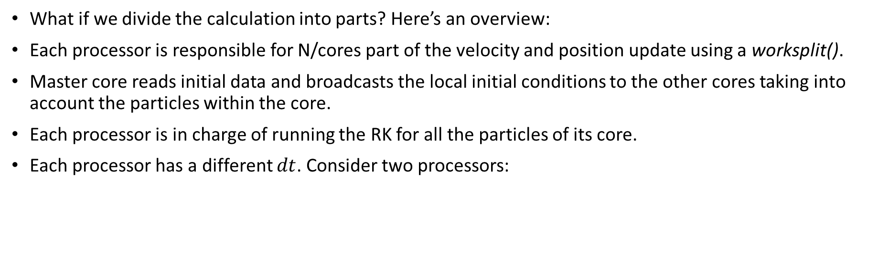
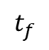
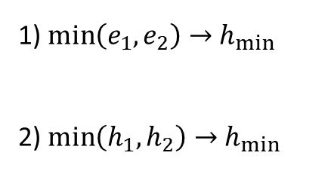
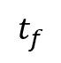
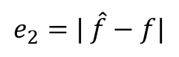
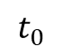
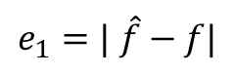
Parallelization
What if we divide the calculation into parts? Here’s an overview:
Each processor is responsible for N/cores part of the velocity and position update using a worksplit().
Master core reads initial data and broadcasts the local initial conditions to the other cores taking into account the particles within the core.
Each processor is in charge of running the RK for all the particles of its core.
Each processor has a different $dt$. Consider two processors:
$$t_{0}$$
$$h_{1}$$
$$t_{f}$$
1) $\min\left(e_{1},e_{2}\right)→$ $h_{min}$
2) $\min\left(h_{1},h_{2}\right)→$ $h_{min}$
Processor 0
$$e_{1}=| \hat{f}−f|$$
$$t_{0}$$
$$h_{2}$$
$$t_{f}$$
Processor 1
$$e_{2}=| \hat{f}−f|$$
$$h_{2}=h_min$$

Slide 15
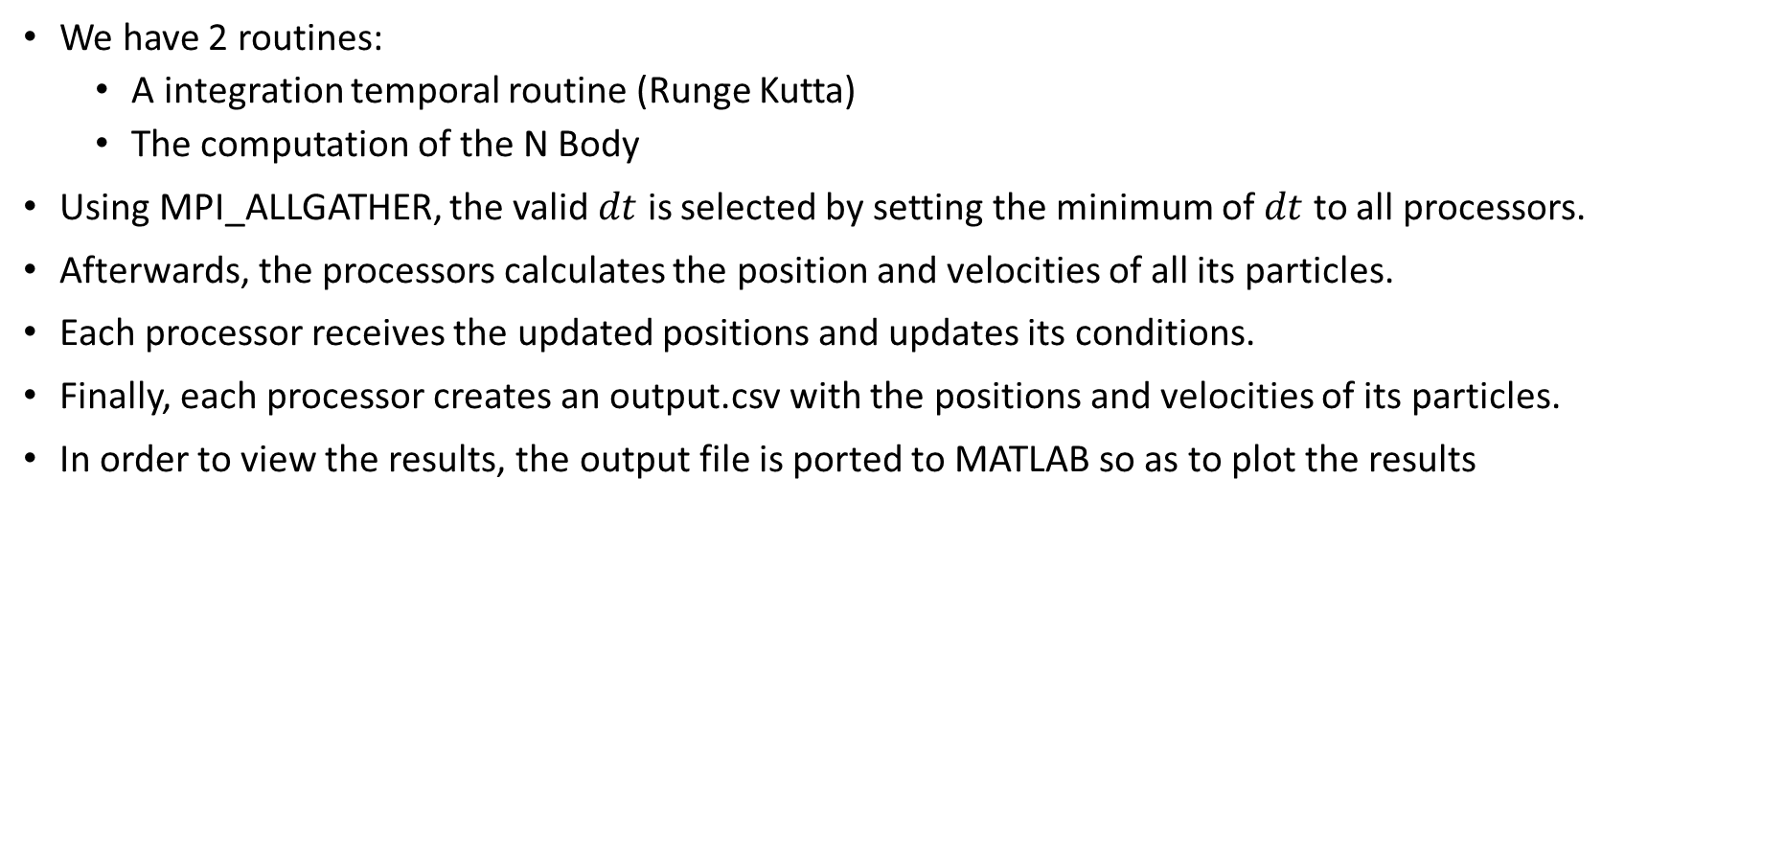
Parallelization (cont.)
We have 2 routines:
A integration temporal routine (Runge Kutta)
The computation of the N Body
Using MPI_ALLGATHER, the valid $dt$ is selected by setting the minimum of $dt$ to all processors.
Afterwards, the processors calculates the position and velocities of all its particles.
Each processor receives the updated positions and updates its conditions.
Finally, each processor creates an output.csv with the positions and velocities of its particles.
In order to view the results, the output file is ported to MATLAB so as to plot the results

Slide 16
Parallelization (cont.)
We have 3 files:
main_NBP_MPI.c which is the main file.
Nbodylib.h which contains all the #define and MACROS.
Nbodylib.c which contains the functions worksplit() and Nbody().

Slide 17
Parallelization (cont.)
// Data calculations
double V1 = Vx(M0,R1); // Mercury velocity
double T1 = Tx(M0,R1); // Mercury period
double V2 = Vx(M0,R2); // Venus velocity
double T2 = Tx(M0,R2); // Venus period
double V3 = Vx(M0,R3); // Earth velocity
double T3 = Tx(M0,R3); // Earth period
double V4 = Vx(M0,R4); // Mars velocity
double T4 = Tx(M0,R4); // Mars period
double V5 = Vx(M0,R5); // Jupiter velocity
double T5 = Tx(M0,R5); // Jupiter period
double V6 = Vx(M0,R6); // Saturn velocity
double T6 = Tx(M0,R6); // Saturn period
double V7 = Vx(M0,R7); // Uranus velocity
double T7 = Tx(M0,R7); // Uranus period
double V8 = Vx(M0,R8); // Neptune velocity
double T8 = Tx(M0,R8); // Neptune period
double V9 = Vx(M0,R9); // Pluto velocity
double T9 = Tx(M0,R9); // Pluto period
// Main
int main(int argc, char* argv[]) {
int r; // For error checking
// Start MPI
r = MPI_Init(&argc, &argv);
checkr(r, "Initiate");
MPI_Status st;
// Check rank and size of the processors
int rank, size;
rank = proc();
size = nproc();
array_size = size;
planet2proc = (int*)malloc(sizeof(int)*array_size);
// If the processor is higher than the number of processors, exit
if (rank >= size) {exit(-1);}
// Declare worksplit variables
int mystart,mylocstart;
int myend, mylocend;
int bodies;
for (int xproc=0; xproc<size; xproc++) {
worksplit(&mystart, &myend, xproc, size, 0, NBODY - 1);
if (xproc == rank) {
bodies = myend - mystart + 1;
mylocstart = mystart;
mylocend = myend;
}
planet2proc[xproc] = myend;
}
// Integration bounds and initial solution
double tspan[2] = {0.,T9};
// All initial conditions
double *y0_loc;
y0_loc = (double *)malloc(bodies*6*sizeof(double));
// Global initial conditions for all particles
for(int planet_p = 6*mylocstart; planet_p < (6*(mylocend + 1)); planet_p++) {
double y0_temp[N] = {0., 0., 0., 0., 0., 0., /* Sun */
R1, 0., 0., 0., V1, 0., /* Mercury */
0., R2, 0., -V2, 0., 0., /* Venus */
0., R3, 0., -V3, 0., 0., /* Earth */
0., R4, 0., -V4, 0., 0., /* Mars */
0., R5, 0., -V5, 0., 0., /* Jupiter */
0., R6, 0., -V6, 0., 0., /* Saturn */
0., R7, 0., -V7, 0., 0., /* Uranus */
0., R8, 0., -V8, 0., 0., /* Neptune */
0., R9, 0., -V9, 0., 0. /* Pluto */
};
y0_loc[planet_p-6*mylocstart] = y0_temp[planet_p];
}

Slide 18
Parallelization (cont.)
// Runge-Kutta parameters
RK_PARAM rkp = rkparams(tspan);
rkp.h0 = 24.*3600.;
rkp.eps = 1e-11;
// Launch the integrator
RK_OUT rko = odeRK("hiroshi912", NBody, tspan, y0_loc, 6*bodies, &rkp);
// Finish
printf("error = %.2e with %d steps\n", rko.err, rko.n);
char str[15+nproc()];
for(int xproc = 0; xproc < nproc(); xproc++) {
if(xproc == proc()) {
sprintf(str, "Output%d.csv", xproc);
writerkout(str, &rko, 6*bodies);
}
}
freerkout(&rko);
free(y0_loc);
free(planet2proc);
// Finalise MPI
MPI_Finalize();
// End of the program
exit(0);
}

Slide 19
Parallelization (cont.)
// Worksplit
void worksplit(int *mystart, int *myend, int proc, int nproc, int start, int end)
{
// Number of tasks
int ntask = end - start + 1;
// Number of tasks per processor
int interval = ntask / nproc;
// Tasks left
int remainder = ntask % nproc;
if (ntask < nproc)
{
printf("Less tasks than processors\n");
exit(-1);
}
if (remainder != 0)
{
if (proc < remainder)
{
*mystart = start + proc * (interval + 1);
*myend = *mystart + interval;
}
else
{
*mystart = start + remainder * (interval + 1) + (proc - remainder) * interval;
*myend = *mystart + interval - 1;
}
}
else
{
*mystart = start + proc * interval;
*myend = *mystart + (interval - 1);
}
}

Slide 20
Parallelization (cont.)
void NBody(double t, double* var, int n, double* varp) {
/*
Body 1: Perturbated
var[0] = rx var[3] = vx
var[1] = ry var[4] = vy
var[2] = rz var[5] = vz
Body 2: Perturber
var[6] = rx var[9] = vx
var[7] = ry var[10] = vy
var[8] = rz var[11] = vz
Body 3: Perturber
var[12] = rx var[15] = vx
var[13] = ry var[16] = vy
var[14] = rz var[17] = vz
*/
// varp = prime (derivative of var | var prime)
int r; // for error checking
int start = 0;
MPI_Status st;
if(proc() != 0) {
start = planet2proc[proc()-1] + 1;
}
double* y;
y = (double*)malloc(3*NBODY*sizeof(double));
if (proc() != 0) {
double* pos; // vectors of positions
pos = (double*)malloc(3*(BODIES(proc()))*sizeof(double));
for (int body = 0; body < (BODIES(proc())); body++)
{
pos[3*body] = VAR(body,0);
pos[3*body + 1] = VAR(body, 1);
pos[3*body + 2] = VAR(body, 2);
}
r = MPI_Ssend(pos, 3*(BODIES(proc())), MPI_DOUBLE, 0, proc() + nproc(), MPI_COMM_WORLD);
checkr(r, "send");
free(pos);
r = MPI_Recv(y, 3*NBODY, MPI_DOUBLE, 0, proc(), MPI_COMM_WORLD, &st);
checkr(r, "receive");
}
else { // If rank == 0
double* var_loc;
// var_loc = (double*)malloc(3*(BODIES(1))*sizeof(double));
for (int y_counter = 0; y_counter <= planet2proc[0]; y_counter++) {
Y(y_counter,0) = VAR(y_counter,0);
Y(y_counter,1) = VAR(y_counter,1);
Y(y_counter,2) = VAR(y_counter,2);
}
for (int xproc = 1; xproc < nproc(); xproc++) {
var_loc = (double*)malloc(3*(BODIES(xproc))*sizeof(double));
// var_loc = realloc(var_loc,3*(BODIES(xproc))*sizeof(double));
r = MPI_Recv(var_loc, 3*(BODIES(xproc)), MPI_DOUBLE, xproc, xproc + nproc(), MPI_COMM_WORLD, &st);
checkr(r, "receive");
for (int p = 0; p < (3*(BODIES(xproc))); p++) {
Y(planet2proc[xproc - 1] + 1,p) = var_loc[p];
}
free(var_loc);
r = MPI_Ssend(y, 3*NBODY,MPI_DOUBLE, xproc, xproc, MPI_COMM_WORLD);
checkr(r, "send");
}
}

Slide 21
Parallelization (cont.)
else { // If rank == 0
double* var_loc;
// var_loc = (double*)malloc(3*(BODIES(1))*sizeof(double));
for (int y_counter = 0; y_counter <= planet2proc[0]; y_counter++) {
Y(y_counter,0) = VAR(y_counter,0);
Y(y_counter,1) = VAR(y_counter,1);
Y(y_counter,2) = VAR(y_counter,2);
}
for (int xproc = 1; xproc < nproc(); xproc++) {
var_loc = (double*)malloc(3*(BODIES(xproc))*sizeof(double));
// var_loc = realloc(var_loc,3*(BODIES(xproc))*sizeof(double));
r = MPI_Recv(var_loc, 3*(BODIES(xproc)), MPI_DOUBLE, xproc, xproc + nproc(), MPI_COMM_WORLD, &st);
checkr(r, "receive");
for (int p = 0; p < (3*(BODIES(xproc))); p++) {
Y(planet2proc[xproc - 1] + 1,p) = var_loc[p];
}
free(var_loc);
r = MPI_Ssend(y, 3*NBODY,MPI_DOUBLE, xproc, xproc, MPI_COMM_WORLD);
checkr(r, "send");
}
}

Slide 22
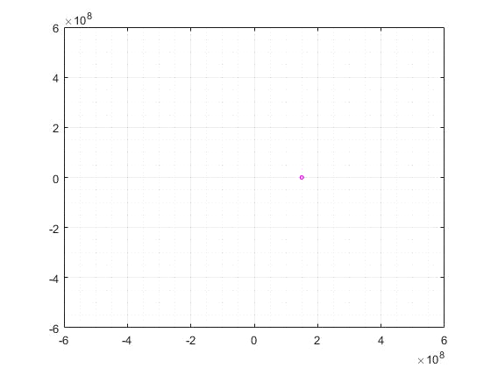
2 Body Sun-Earth (in Serie)

Slide 23
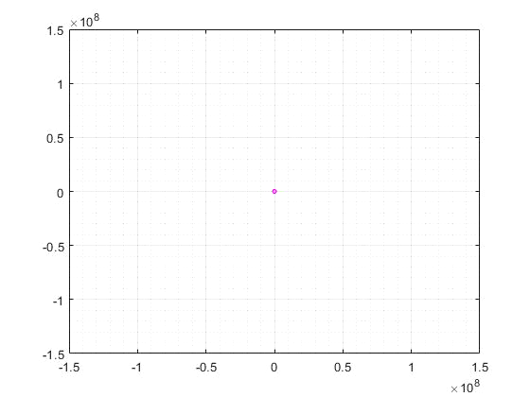
3 Body Sun-Venus-Earth (in Serie)

Slide 24
2 Body Sun-Mercury (in Parallel with 2 cores)
Sun
0 0 0 0 0 0 0
86400 0.0245110000000000 0.000584000000000000 0 1.00000000000000e-06 0 0
250682.142843000 0.205685000000000 0.0142310000000000 0 2.00000000000000e-06 0 0
458056.891552000 0.681010000000000 0.0863840000000000 0 3.00000000000000e-06 1.00000000000000e-06 0
677541.526709000 1.46891300000000 0.277192000000000 0 4.00000000000000e-06 1.00000000000000e-06 0
900692.956362000 2.54390600000000 0.643384000000000 0 5.00000000000000e-06 2.00000000000000e-06 0
1125253.78642900 3.86774100000000 1.23517000000000 0 6.00000000000000e-06 3.00000000000000e-06 0
1350550.43727600 5.39422400000000 2.09511500000000 0 7.00000000000000e-06 4.00000000000000e-06 0
1576340.24726600 7.07035800000000 3.25673900000000 0 8.00000000000000e-06 6.00000000000000e-06 0
1802517.17034800 8.83782300000000 4.74327000000000 0 8.00000000000000e-06 7.00000000000000e-06 0
2029046.25641200 10.6350090000000 6.56691100000000 0 8.00000000000000e-06 9.00000000000000e-06 0
t
x
y
z
vx
vy
vz
Mercury
0 57909227 0 0 0 47.8792710000000 0
86400 57761533.9424860 4133251.54644200 0 -3.41736700000000 47.7571580000000 0
250682.142843000 56669834.6280460 11916728.3596100 0 -9.85273500000000 46.8545430000000 0
458056.891552000 53805683.6141540 21410907.9831080 0 -17.7025100000000 44.4864660000000 0
677541.526709000 49058030.2004960 30769924.2059480 0 -25.4405320000000 40.5611130000000 0
900692.956362000 42580473.3400290 39247698.4597760 0 -32.4499450000000 35.2054770000000 0
1125253.78642900 34603467.9627180 46433592.4855720 0 -38.3912330000000 28.6100990000000 0
1350550.43727600 25405377.1240080 52038882.1201350 0 -43.0256800000000 21.0051290000000 0
1576340.24726600 15305536.0609840 55849967.7614430 0 -46.1766810000000 12.6545920000000 0
1802517.17034800 4655363.32998600 57721796.3189560 0 -47.7243070000000 3.84904100000000 0
2029046.25641200 -6173898.99049100 57579171.0271870 0 -47.6063840000000 -5.10458100000000 0

Slide 25
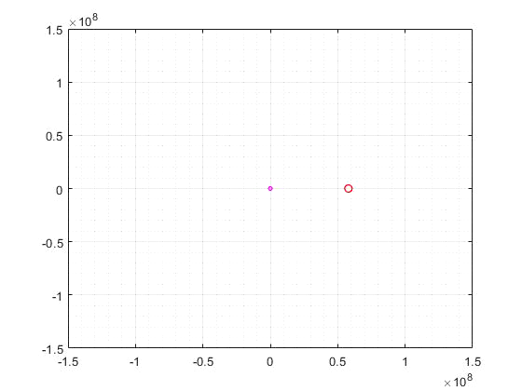
2 Body Sun-Mercury (in Parallel with 2 cores)

Slide 26
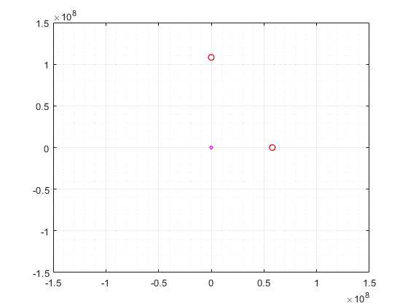
3 Body Sun-Mercury-Venus (in Parallel with 3 cores)

Slide 27
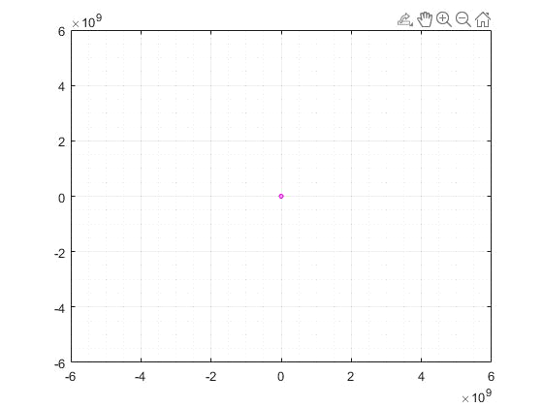
Solar System (in Parallel*)
*Sometimes the program is unstable to overflow

Slide 28
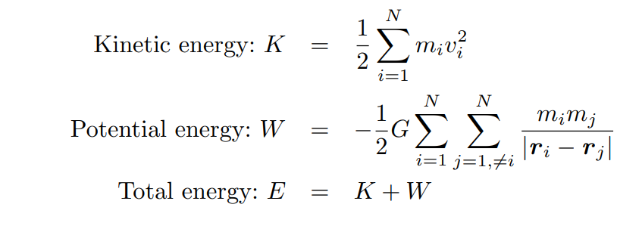
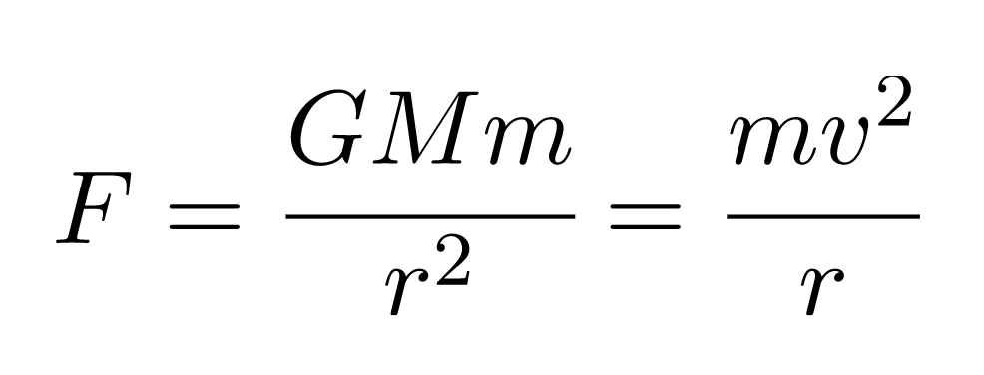
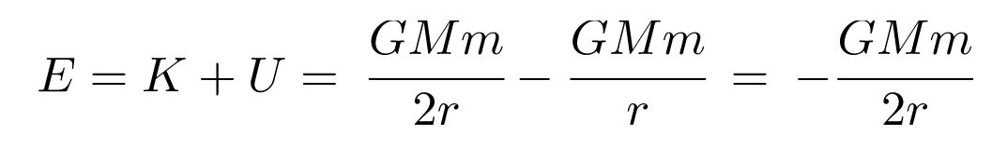
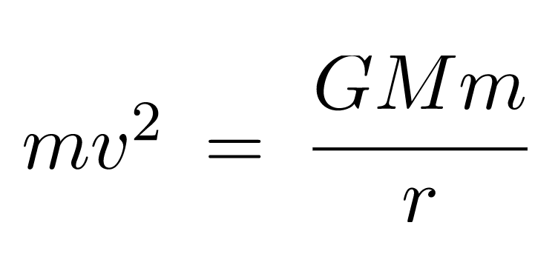
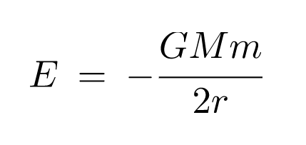
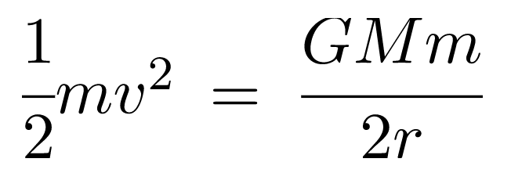
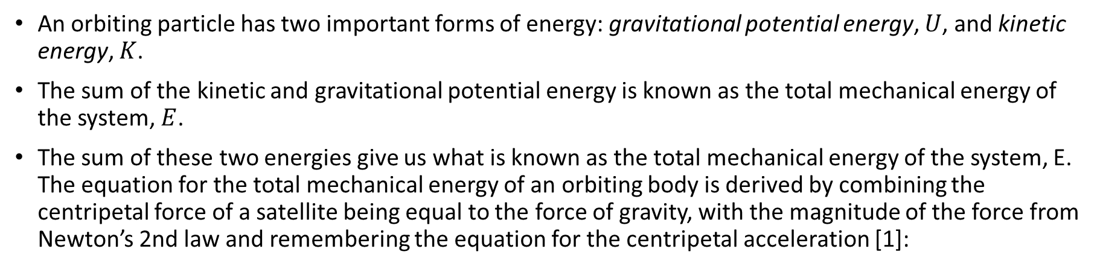
Validation of the results
An orbiting particle has two important forms of energy: gravitational potential energy, $U$, and kinetic energy, $K$.
The sum of the kinetic and gravitational potential energy is known as the total mechanical energy of the system, $E$.
The sum of these two energies give us what is known as the total mechanical energy of the system, E. The equation for the total mechanical energy of an orbiting body is derived by combining the centripetal force of a satellite being equal to the force of gravity, with the magnitude of the force from Newton’s 2nd law and remembering the equation for the centripetal acceleration [1]:
[1] Gieles, M. (University of Cambridge). (2011). Numerical Simulations of the Gravitational N-body problem. https://www.ast.cam.ac.uk/sites/default/files/topics_lecture_mgieles_19112011_0.pdf (accessed: 11-04-2021)
Notes:
https://www.ast.cam.ac.uk/sites/default/files/topics_lecture_mgieles_19112011_0.pdf

Slide 29
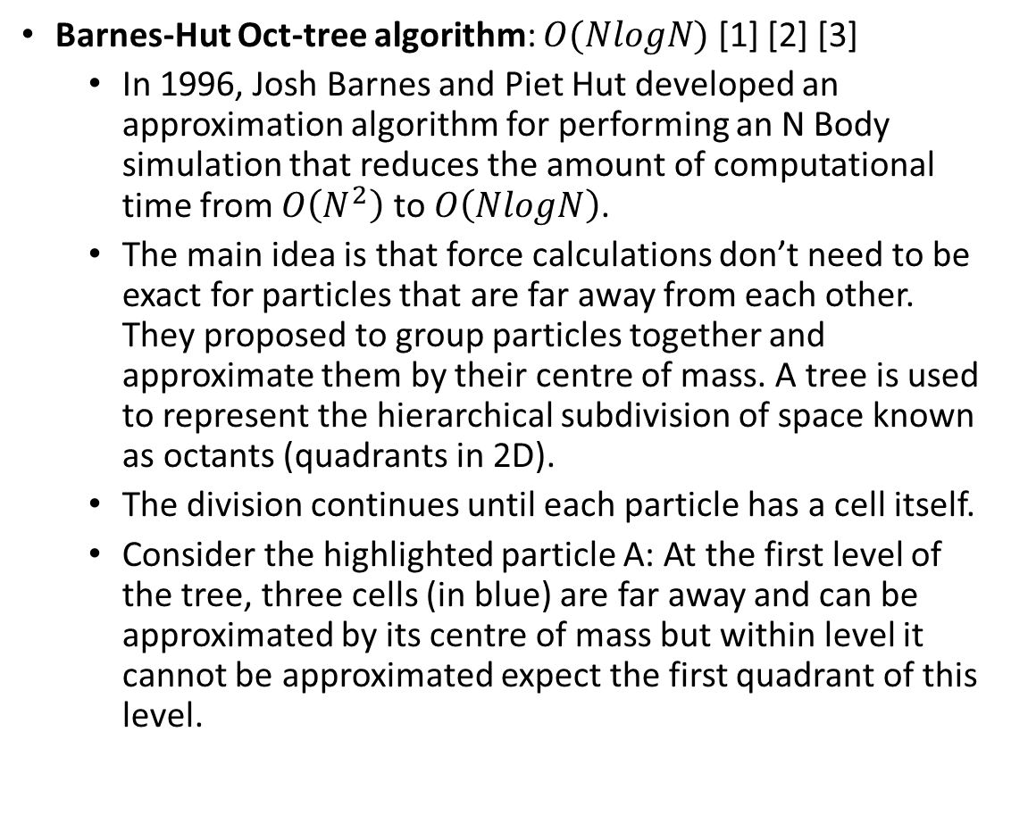
More optimized Algorithms
16 particles in a 2D Domain
Barnes-Hut Oct-tree algorithm: $O(NlogN)$ [1] [2] [3]
In 1996, Josh Barnes and Piet Hut developed an approximation algorithm for performing an N Body simulation that reduces the amount of computational time from $O\left(N^{2}\right)$ to $O\left(NlogN\right)$.
The main idea is that force calculations don’t need to be exact for particles that are far away from each other. They proposed to group particles together and approximate them by their centre of mass. A tree is used to represent the hierarchical subdivision of space known as octants (quadrants in 2D).
The division continues until each particle has a cell itself.
Consider the highlighted particle A: At the first level of the tree, three cells (in blue) are far away and can be approximated by its centre of mass but within level it cannot be approximated expect the first quadrant of this level.
A
Level 0
Root
16
Level 1
5
3
4
4
Level 2
2
1
1
1
.
.
.
[1] Barnes, J., & Hut, P. (1986). A hierarchical O(N log N) force-calculation algorithm. Nature, 324(6096), 446–449. doi:10.1038/324446a0
[2] Greengard, L. (1990). The Numerical Solution of the N-Body Problem. Computers in Physics, 4 (142).
[3] Liu, Pangfeng & Bhatt, Sandeep. (2001). Experiences with parallel N-body simulation. Parallel and Distributed Systems, IEEE.
Notes:
https://www.nature.com/articles/324446a0

Slide 30
Problems encountered
Runge Kutta is strongly non parallelizable.
Adaptative vs. constant time step.
Difficult to verify the results.
Enormous amount of send and receives which results in a slower computational time unless N is considerably high and a decent amount of computer cores.
Several alternative methods where analysed for optimizing sends and receives.
Overflow of data when sending data.

Slide 31
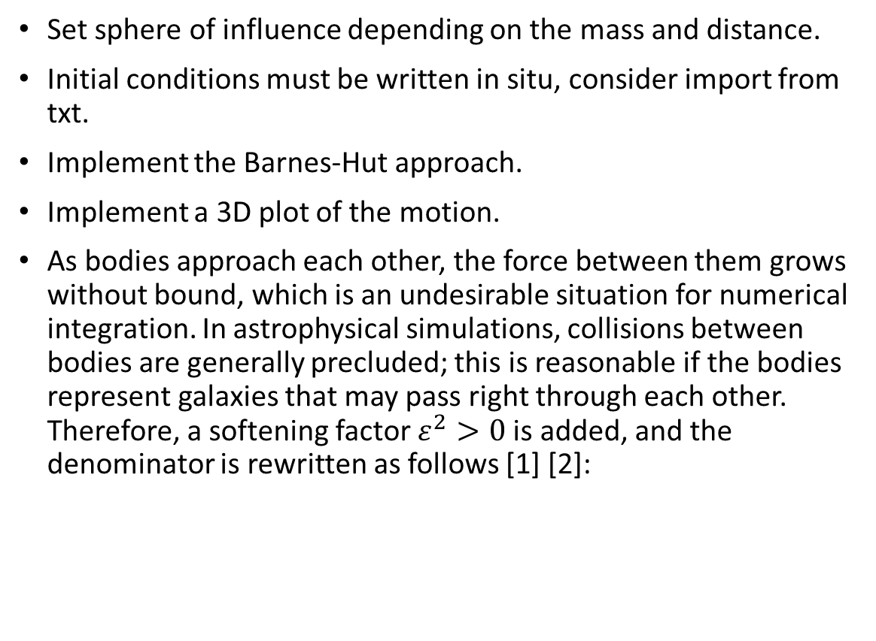
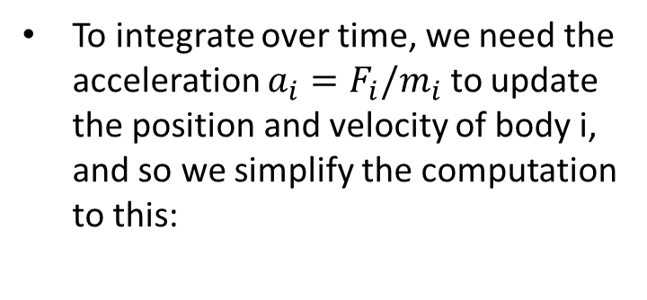
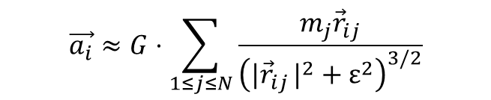

Further improvements
Set sphere of influence depending on the mass and distance.
Initial conditions must be written in situ, consider import from txt.
Implement the Barnes-Hut approach.
Implement a 3D plot of the motion.
As bodies approach each other, the force between them grows without bound, which is an undesirable situation for numerical integration. In astrophysical simulations, collisions between bodies are generally precluded; this is reasonable if the bodies represent galaxies that may pass right through each other. Therefore, a softening factor $ε^{2}>0$is added, and the denominator is rewritten as follows [1] [2]:
To integrate over time, we need the acceleration $a_{i}=F_{i}/m_{i}$ to update the position and velocity of body i, and so we simplify the computation to this:
$$\vec{a_{i}}≈G⋅\sum_{1≤j≤N}{\frac{m_{j}{\vec{r}}_{ij}}{{\left(\left.|{\vec{r}}_{ij}\right.|^{2}+ε^{2}\right)}^{3/2}}}$$
$$\vec{F_{i}}≈Gm_{i}⋅\sum_{1≤j≤N}{\frac{m_{j}{\vec{r}}_{ij}}{{\left(\left.|{\vec{r}}_{ij}\right.|^{2}+ε^{2}\right)}^{3/2}}}$$
[1] Nyland, L., Harris, M., & Prins, J. (2009). Fast N-body simulation with CUDA NVIDIA
[2] Dyer, Charles, and Peter Ip. 1993. "Softening in N-Body Simulations of Collisionless Systems." The Astrophysical Journal 409, pp. 60–67.

Slide 32
Conclusions
All pairs N-body is a brute-force, simple, high performance method. Nevertheless, there are other more efficient algorithms.
There is a trade-off between:
Maximizing parallelism
More work per processor
The most efficient way is to increase the amount of work on each processor and reducing the amount of parallelism as the speed of the communications between a single processor is faster than communicating between processors.
The problem is implemented in 3D but the resultant plots are 2D.
We learned how to version control our codes and work in a repository as a group using git.
We have struggled a lot but we have been able to view programming from another point of view. Besides, we been able to think differently as we learned how memory is structured in a computer.
We also learned how to debug effectively, for instance, we used valgrind tool to view where memory had conflicts.
After this, we aim to develop code using MPI in our future problems.

